Slide 1
What is an isotope?

Slide 2
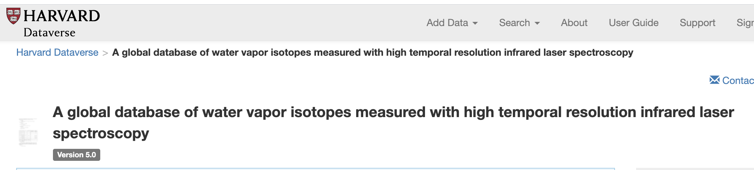
Data Source

Slide 3
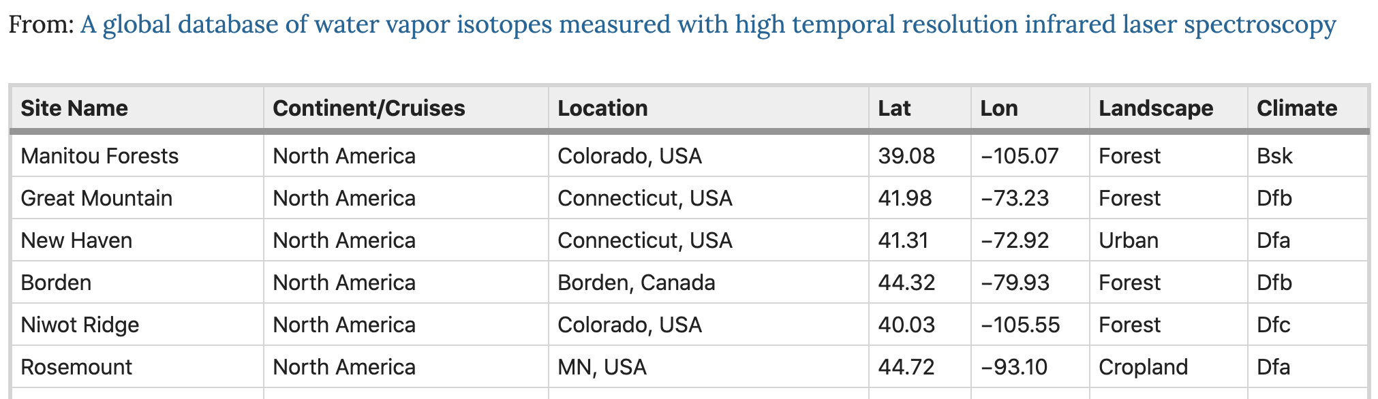
Data Source

Slide 4
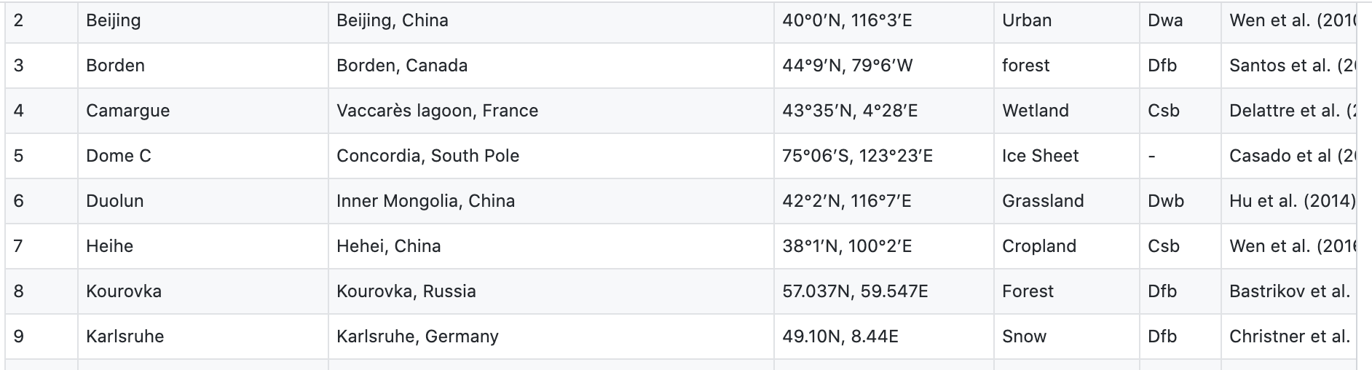
Data Source

Slide 5
Sample locations

Slide 6
Data timeframes

Slide 7
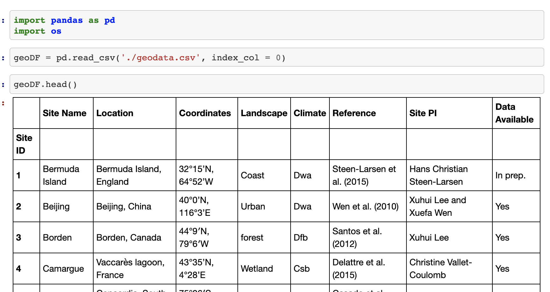
Pandas

Slide 8
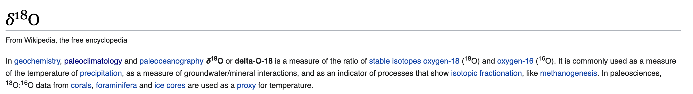
Delta O-18

Slide 9
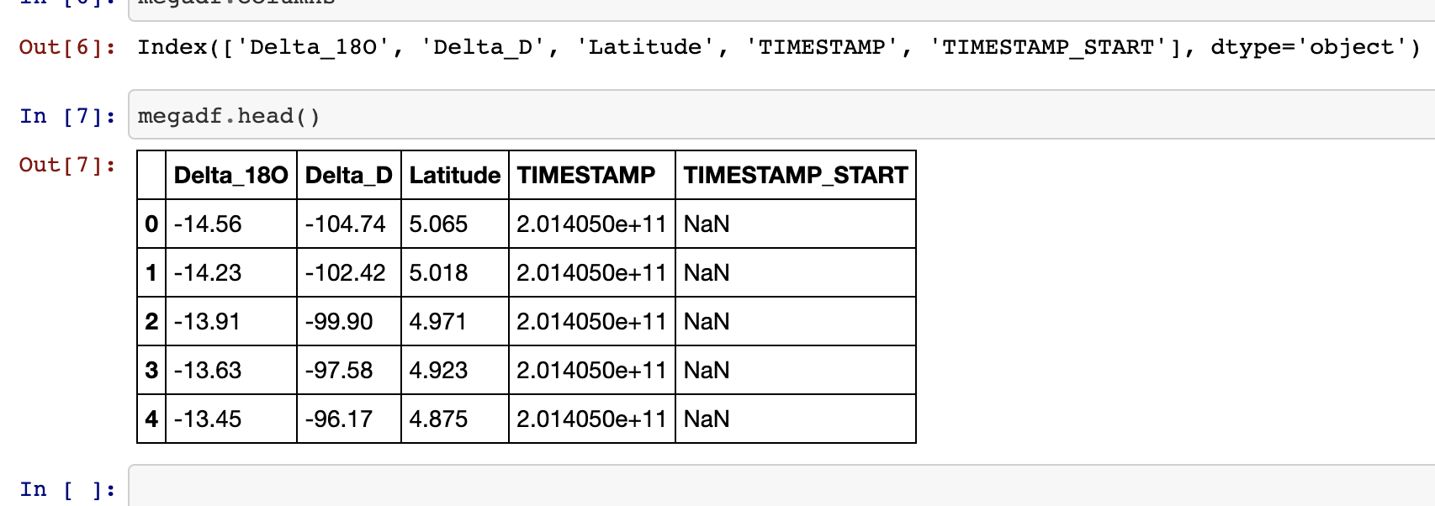
Pandas

